Slide 1
SUPPLY CHAIN MANAGEMENT DASHBOARD
Domain: Business Analyst
Tools Used: Power BI, Excel
Project Level: Intermediate
Dataset: Fashion & Beauty Supply Chain Dataset.
Description:
Analysis of end-to-end supply chain operations
Covers inventory, logistics, suppliers, and revenue
Focuses on efficiency, cost control, and performance
Supports data-driven operational decisions

Slide 2
PROBLEM STATEMENT
Supply chain involves multiple interconnected processes
Lack of analytics impacts visibility and decision-making
Challenges Addressed:
Monitoring inventory levels and reorder points
Tracking logistics and delivery performance
Evaluating supplier reliability and quality
Managing inventory health and turnover
Analyzing revenue and growth trends

Slide 3
PROJECT OBJECTIVES
Analyze overall supply chain performance
Track revenue, cost, profit, and margins
Monitor logistics efficiency and delivery SLA
Evaluate supplier reliability and defect rates
Identify inventory risks and reorder requirements
Provide time-based revenue and growth insights

Slide 4
DATA PREPARATION
Steps Performed:
Data import into Power BI
Data cleaning and validation
Field standardization
Relationship creation
Key Data Fields:
Product Type, Supplier Name
Revenue, Cost, Orders, Shipments
Inventory Levels, Lead Times
Shipping Cost, Routes, SLA
Purpose:
Ensure accurate, consistent, and reliable analysis

Slide 5
KPIs & CALCULATIONS
Key KPIs Created
Total Revenue=SUM( FactProduct[RevenueGenerated] )
Total Cost=SUM( FactProduct[Costs] )SUM( FactManufacturing[ManufacturingCosts] )SUM( FactShipment[ShippingCosts] )
Gross Profit = [Total Revenue] - [Total Cost]
Profit Margin % = DIVIDE ( [Gross Profit], [Total Revenue] )
Total Orders = COUNTROWS( FactSalesOrder )
Stock Availability % = DIVIDE (SUM ( FactProduct[StockLevels] ),SUM ( FactProduct[StockLevels] ) + SUMFactProduct[NumberOfProductsSold] ))
Inventory Value = SUMX(FactProduct,COALESCE( FactProduct[StockLevels], 0 ) * COALESCE( FactProduct[Costs], 0 ))
Days of Inventory = DIVIDE ([Total Stock Levels],[Avg Daily Demand])
Purpose:
Measure financial performance and operational efficiency

Slide 6
VISUALIZATION & INTERACTIVITY
Visualization Techniques Used
KPI Cards for summary metrics
Line Charts for trend analysis
Bar Charts for comparison
Tables for detailed insights
Gauge chart for stock availability
Interactivity:
Slicers: Year, Product Type, Supplier, Month, Shipping Carrier
Clear slicer button
Cross-filtering across visuals

Slide 7
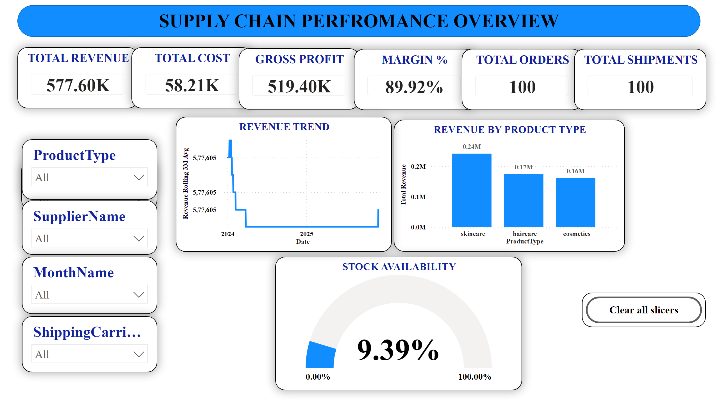
Highlights:
Total Revenue: 577.60K
Gross Profit: 519.40K
Margin: 89.92%
Total Orders & Shipments: 100
Stock Availability: 9.39%
Business Insight:
Provides a high-level snapshot of supply chain health and profitability

Slide 8
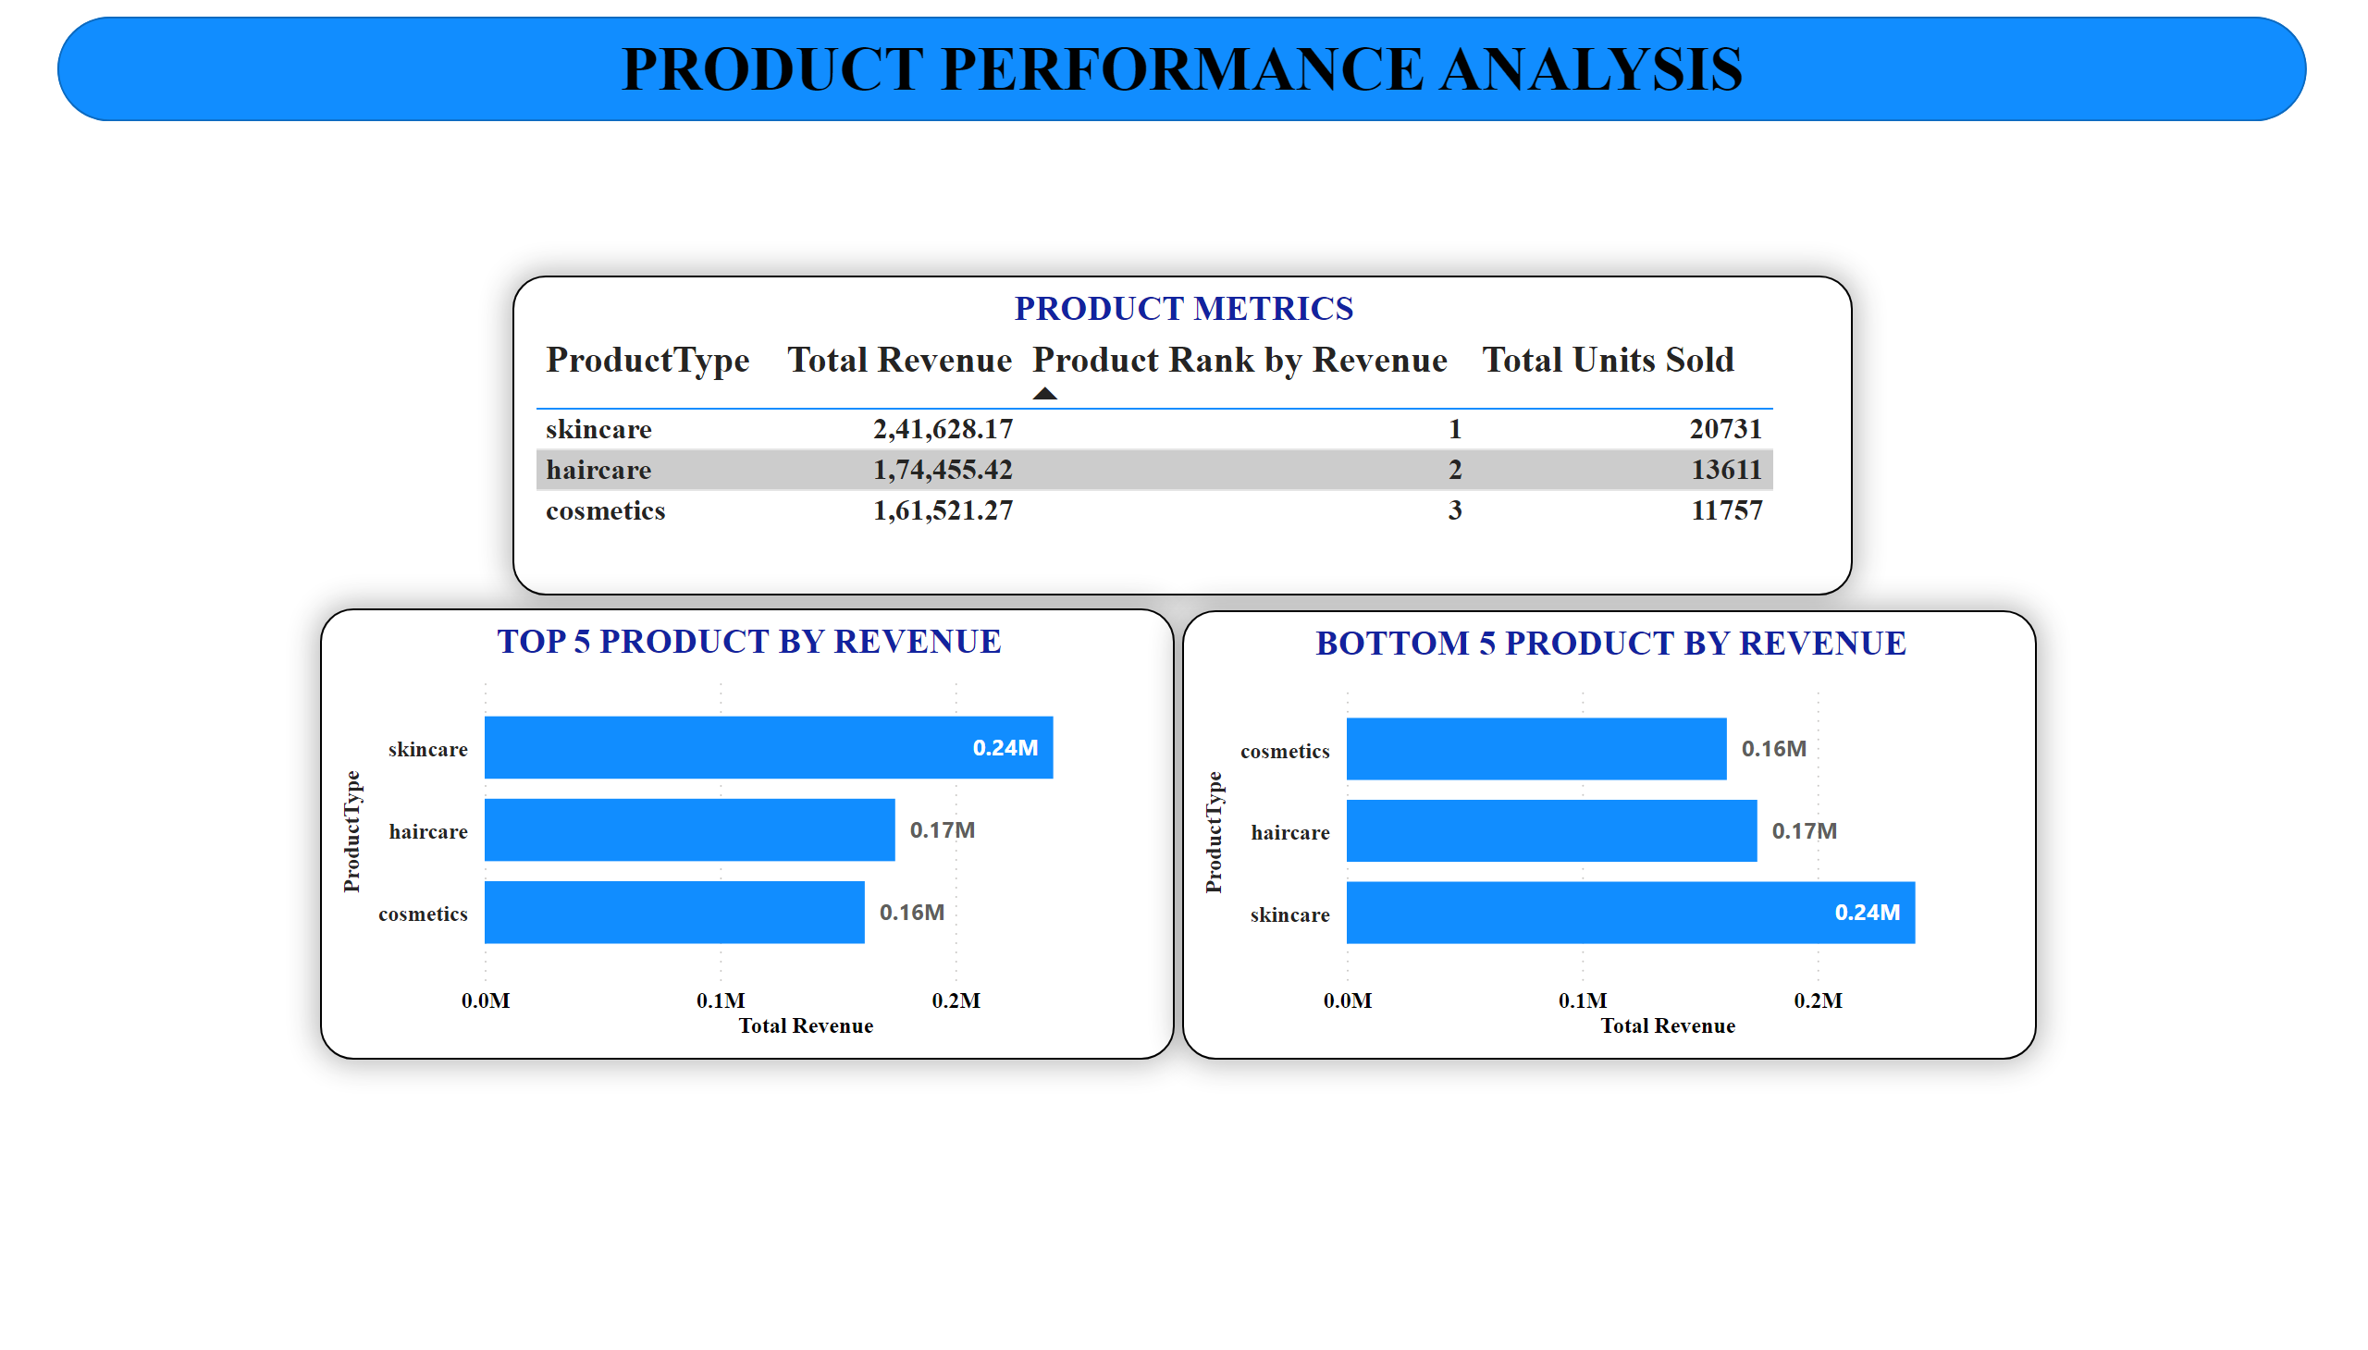
Insights:
Revenue performance by product type
Product ranking based on revenue
Units sold comparison across products
Cosmetics, Haircare, and Skincare show balanced revenue
Business Insight:
Helps identify top-performing and underperforming product categories

Slide 9
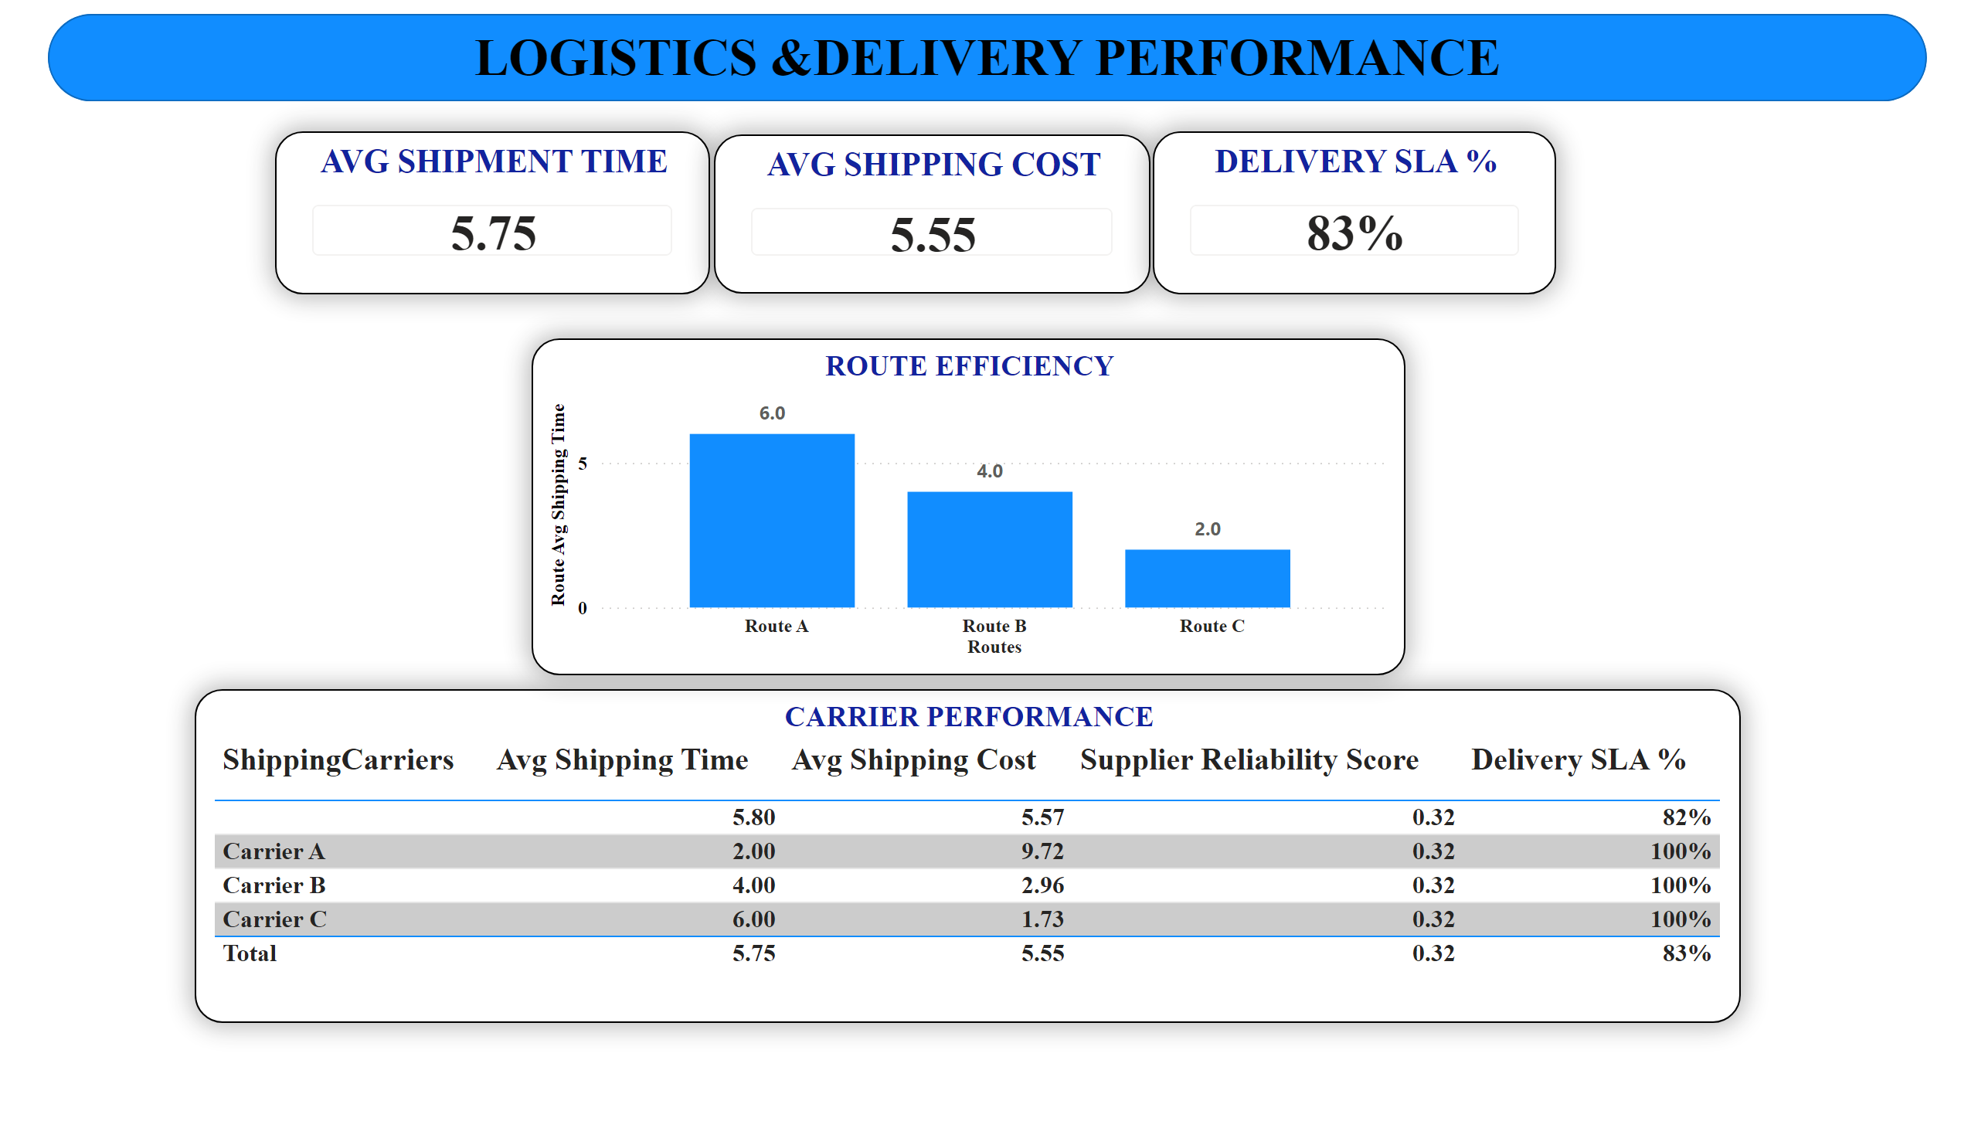
Insights:
Average shipment time: 5.75 days
Average shipping cost: 5.55
Delivery SLA achieved: 83%
Carrier and route efficiency comparison
Business Insight:
Enables optimization of delivery routes and carrier selection

Slide 10
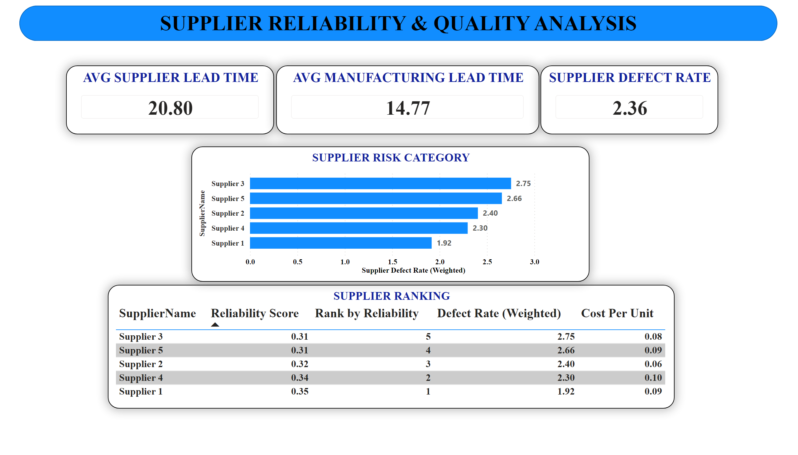
Insights:
Average supplier lead time: 20.80 days
Manufacturing lead time: 14.77 days
Supplier defect rate: 2.36
Supplier ranking based on reliability
Business Insight:
Supports supplier selection and risk mitigation decisions

Slide 11
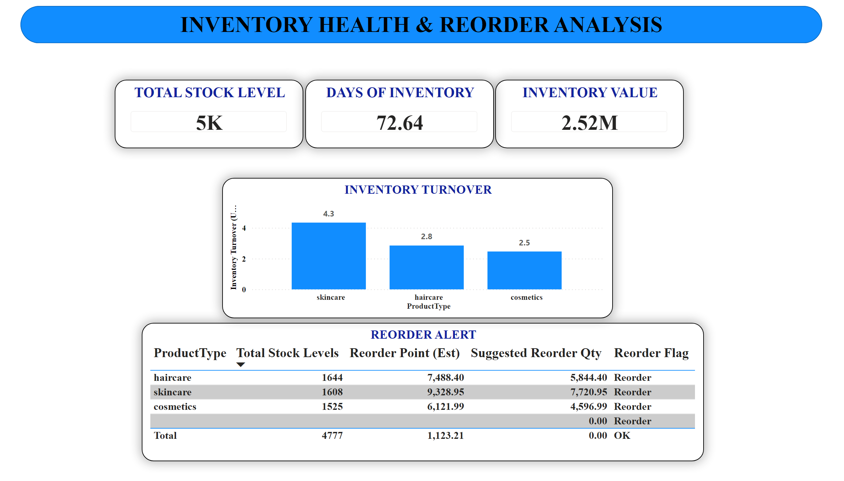
Insights:
Total stock level: 5K units
Days of inventory: 72.64
Inventory value: 2.52M
Reorder alerts identified for specific products
Business Insight:
Prevents stock-outs and over-stocking through proactive planning

Slide 12
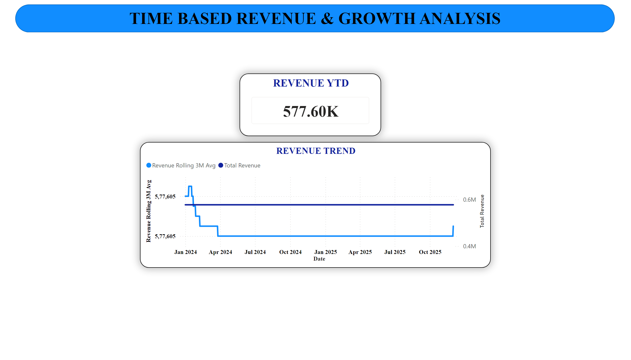
Insights:
Revenue YTD: 577.60K
Rolling 3-month revenue trends
Stable revenue pattern with minor fluctuations
Business Insight:
Helps track growth patterns and seasonality over time

Slide 13
KEY FINDINGS
Key Findings
Supply chain shows strong profitability with high margins
Logistics performance meets SLA in most cases
Certain products require immediate reorder action
Supplier defect rates remain within acceptable range
Time-based analysis shows stable revenue growth

Slide 14
CONCLUSION & FUTURE SCOPE
Conclusion
The dashboard provides a comprehensive view of supply chain operations
Enables data-driven decisions across inventory, logistics, and suppliers
Improves efficiency, cost control, and service levels
Future Enhancements
Integration with real-time supply chain data
Advanced forecasting for demand and inventory
Predictive supplier risk analysis
Automation of reorder alerts

